Slide 1
A1 Chemistry
Atomic Structure

Slide 2
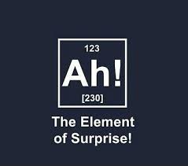

Slide 3
Learning Intentions
elements are represented by symbols
atoms can be modelled as a nucleus, surrounded by electrons in distinct energy levels, held together by electrostatic forces of attraction between the nucleus and electrons
isotopes are atoms of an element with the same number of protons but different numbers of neutrons and are represented in the form ^{A} X (IUPAC) or X-A
ions are atoms or groups of atoms that are electrically charged due to a loss or gain of electrons

Slide 4
isotopes of an element have the same electron configuration and possess similar chemical properties but have different physical properties
the relative atomic mass (atomic weight), Ar is the ratio of the average mass of the atom to 1/12 the mass of an atom of 12C; relative atomic masses of the elements are calculated from their isotopic composition
mass spectrometry involves the ionisation of substances and the separation and detection of the resulting ions; the spectra which are generated can be analysed to determine the isotopic composition of elements and interpreted to determine relative atomic mass

Slide 5
Success Criteria
Identify the number of protons, neutrons and electrons in an isotope or ion
Write the IUPAC symbol for elements
Explain the difference between mass number and relative atomic mass
Calculate relative atomic mass for samples with different proportions of isotopes

Slide 6
Key words
nucleus
protons, neutrons, electrons
energy levels
electrostatic
isotope
IUPAC
ion
atomic number (A)
mass number (Z)
relative atomic mass (“atomic weight”)
mass spectrometry

Slide 7
Atomic structure
Nucleus contains protons and neutrons
surrounded by a “cloud” of electrons.
Electrons are found in distinct energy levels.
positive
neutral
(no charge)
negative

Slide 8
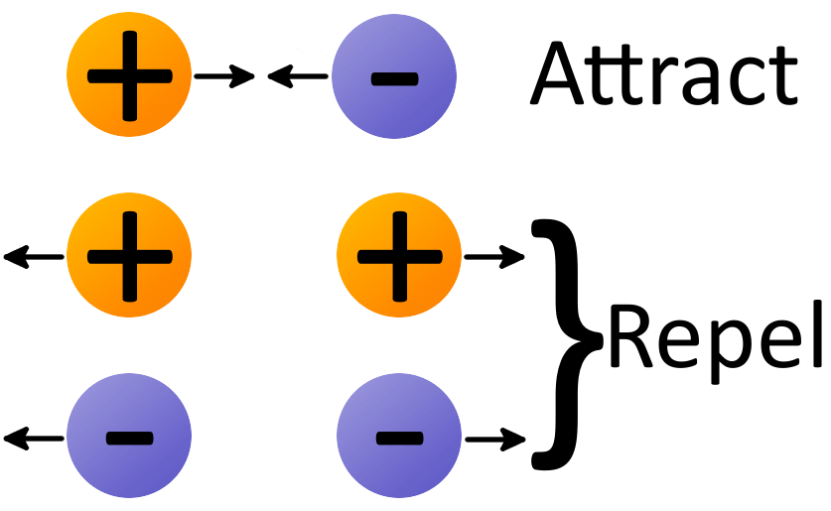
Electrostatic attraction between positive protons, (neutral neutrons) and negative electrons hold the atom together.

Slide 9
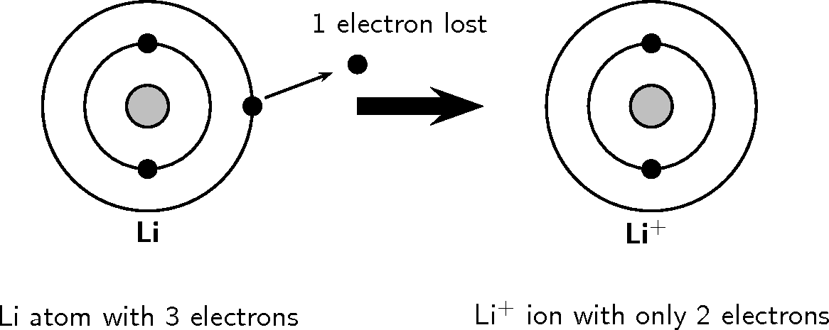
Ions
Atoms (or groups of atoms) can lose or gain electrons (ionise) to become charged particles (ions).

Slide 10
Protons and neutrons are almost identical in size and mass.
The nucleus contains almost all of the mass of the atom, despite taking up less than 10⁻¹² of its volume.

Slide 11
Most of the atom is empty space, through which negatively charged electrons orbit at high speed.
Electrons are much smaller and lighter than protons and neutrons, and so contribute almost no mass to the atom.

Slide 12


Slide 13
Atomic number
The atomic number (Z) of any atom is the number of protons in the nucleus.
The atomic number defines the element,
ie all hydrogen atoms have 1 proton,
all helium atoms have 2 protons
and so on…

Slide 14
Mass number
The relative mass of a proton or neutron is 1
atomic mass unit
(One atomic mass unit is equal to 1/12th of the mass of one carbon-12 atom).
The mass number (A) of a particular atom is the number of protons plus neutrons in that atom.

Slide 15
mass number
A
X
element symbol
Z
atomic number

Slide 16
¹⁴C
C-14
carbon - 14
IUPAC

Slide 17
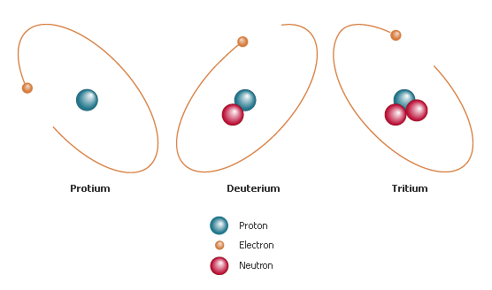
Isotopes
Atoms of the same element have the same number of protons, but may have a different number of neutrons.

Slide 18
These different forms of the same element are called isotopes, and are distinguished by their different mass numbers.
Isotopes share chemical properties, but have different physical properties.

Slide 19
Relative atomic mass
“atomic weight”
The average mass number of atoms of that element.
Determined by isotopic composition – ie proportion of each isotope.

Slide 20
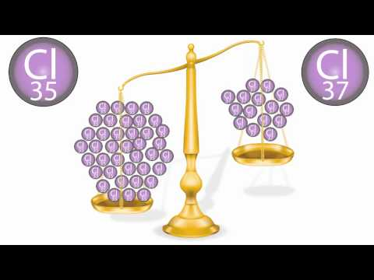

Slide 21
Example Question
Chlorine
Mass number | Abundance
63 | 69%
65 | 31%

Slide 22
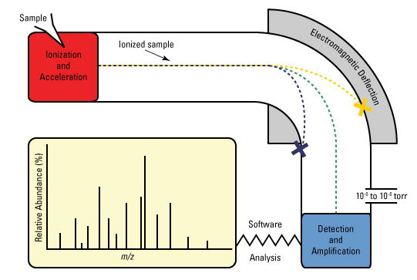
Mass spectroscopy

Slide 23
Review objectives
elements are represented by symbols
atoms can be modelled as a nucleus, surrounded by electrons in distinct energy levels, held together by electrostatic forces of attraction between the nucleus and electrons
isotopes are atoms of an element with the same number of protons but different numbers of neutrons and are represented in the form ^{A} X (IUPAC) or X-A
ions are atoms or groups of atoms that are electrically charged due to a loss or gain of electrons
isotopes of an element have the same electron configuration and possess similar chemical properties but have different physical properties
the relative atomic mass (atomic weight), Ar is the ratio of the average mass of the atom to 1/12 the mass of an atom of 12C; relative atomic masses of the elements are calculated from their isotopic composition
mass spectrometry involves the ionisation of substances and the separation and detection of the resulting ions; the spectra which are generated can be analysed to determine the isotopic composition of elements and interpreted to determine relative atomic mass

Slide 24
Success Criteria
Identify the number of protons, neutrons and electrons in an isotope or ion
Write the IUPAC symbol for elements
Explain the difference between mass number and relative atomic mass
Calculate relative atomic mass for samples with different proportions of isotopes

Slide 25
Review key words
nucleus
protons, neutrons, electrons
energy levels
electrostatic
isotope
IUPAC
ion
atomic number (A)
mass number (Z)
relative atomic mass (“atomic weight”)
mass spectrometry

Slide 26
Next lesson
History of the development of atomic theory

Slide 27
Practice…
Set 1.1, 1.2 and 1.7
Set 8

